Slide 1
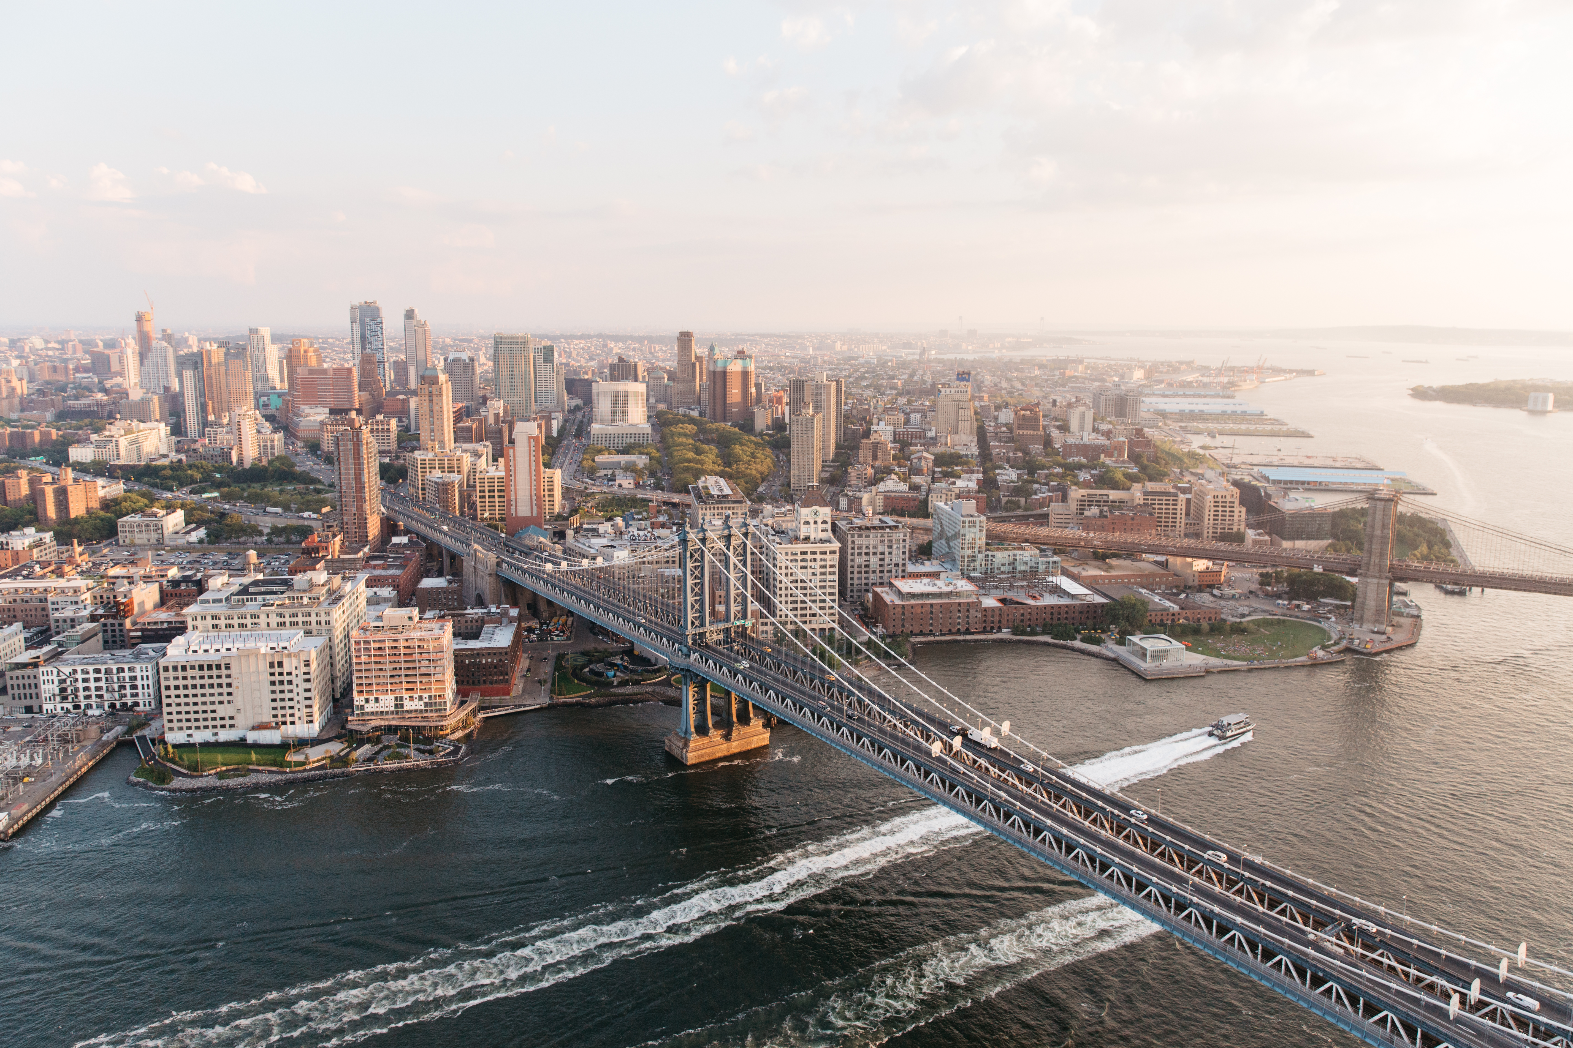
PLAN, IMPLEMENT AND MANAGE EMAIL MARKETING
{Jung Education}
{Yangha Park}
{4/11/2018}

Slide 2
contents
Organisation overview and research
Email marketing strategy
Implementation plan

Slide 3

Stage 1.
Organisation OVERVIEW AND RESEARCH

Slide 4
ORGANISATION OVERVIEW
Provide an overview of the organisation you have selected for the purpose of this assessment and answer the key questions below in your description.
What is the name of the organisation? Jung Education
Please provide a brief history of the organisation. Established in 2006
What products and/or services does the organisation offer? Education
What is the pricing tier of the products and/or services offered? Various
What are the main sales channels? Naver Blog
Where is the organisation located? Sydney
What geographies does the organisation work in? Sydney
Who is the organisation’s target audience? 20-40 years old Korean living in Sydney with temporary visa and 18-40 years old Koreans who want to study in Australia.

Slide 5
EMAIL MARKETING
GLOBAL TRENDS AND OPPORTUNITIES
Case Study | Stockholm university | University of Canberra | UTS
Geography | Sweden | Australia | Australia
Marketing Objective | Increase their reputation, Increase number of people who are interested with them. More students. | More international students. | Increase their reputation, Increase number of people who are interested with them. More international students.
Marketing Solution | Providing useful information via their newsletter. Providing free consultant with alumni. | Providing a lot of information about their course, student visa, accommodation, and etc. | Providing interesting articles that are related with their courses. Introducing their research.
Primary Benefit(s) | Subscribers. | International students. | Subscribers. International students.
Secondary Benefit(s) | Strengthen competitiveness in the education industry. Get higher reputation. | More influence in Canberra. | Strengthen competitiveness in the education industry. Get higher reputation.

Slide 6
Stage 2.
EMAIL MARKETING STRATEGY

Slide 7
EMAIL MARKETING
STRATEGIC IDEAS
Primary Objective | Category | Content Ideas | Second Marketing Benefits
More subscribers | Industry news | Providing update news of immigration of Australia | Higher reputation
More applicants | Promotion | Providing a giveaway who apply for a student visa in certain period. | Build a new relation with a company(partnership)
More subscribers | How to guide | Providing useful information about living in Australia | Having people to like, follow our social media account.

Slide 8
EMAIL MARKETING
STRATEGY
Email campaign Type | Campaign strategic idea | Database segment | Length of campaign | Frequency | Key Performance Indicators (KPIs) | KPI targets (per month)
Lead nurturing campaign | Providing useful information via e-mail about student visa and living in Australia | All | Always On | Once per a month | Open rate | 10%
 |  |  |  |  | Subscribers | 50
Industry update | Immigration news | All | Always On | N/A | Open rate | 20%
 |  |  |  |  | Subscribers | 100
Promotional | Giveaway | All except existing customers | Always On | Twice per a year | Sales | 50
Company update | Adding company news to immigration news | All | Always On | N/A | Open rate | 20%
 |  |  |  |  | Subscribers | 100
Email Surveys | Asking customers what they are not satisfied with us. | Existing customers | Always On | Quarterly | Reply | 50
 |  |  |  | Overall KPI

Slide 9
EMAIL MARKETING
BUDGET OVERVIEW
Campaign | Expense Category | Expense Item | Forecasted Monthly Budget | Reporting Frequency | Budget Approval
Overall | Management | E-mail marketer | $3,600 | Weekly | General Manager
Giveaway | Promotion | Copywriter Graphic Designer | $200 $300 | When it implements | General Manager
Industry update | Industry news | Copywriter Graphic Designer | $200 $300 | When it implements | General Manager
Lead nurturing campaign | Providing useful information via e-mail about student visa and living in Australia | Copywriter Graphic Designer | $200 $300 | When it implements | General Manager
Campaign 4
Totals___

Slide 10
Stage 3.
MAINSTREAM SOCIAL MARKETING IMPLEMENTATION PLAN

Slide 11
EMAIL MARKETING CALENDAR
MONTH:
Sunday | Monday | Tuesday | Wednesday | Thursday | Friday | Saturday
1 | 2 | 3 | 4 | 5 | 6 | 7
 | Lead nurturing campaign
8 | 9 | 10 | 11 | 12 | 13 | 14
 | Industry update
15 | 16 | 17 | 18 | 19 | 20 | 21
22 | 23 | 24 | 25 | 26 | 27 | 28
29 | 30
 | Giveaway

Slide 12
EMAIL MARKETING
IMPLEMENTATION PLAN
Strategy | Action Required | Owner | Start date | Due date
Lead nurturing campaign | Copywrite | Marketing staff 1 | 2/11 | 7/11
 | E-mail Design | Marketing staff 2 | 2/11 | 7/11
Industry update | Copywrite | Marketing staff 1 | 9/11 | 14/11
 | E-mail Design | Marketing staff 2 | 9/11 | 14/11
Giveaway | Copywrite | Marketing staff 1 | 30/11 | 4/12
 | E-mail Design | Marketing staff 2 | 30/11 | 4/12
 | Seek a partnership | General Manager | 30/11 | 4/12
Campaign 4

Slide 13

Email marketing
CAMPAIGN 1 CONTENT
Campaign Name: Lead nurturing campaign
Subject line: | (Jung Education) Useful tips for saving more money in living!
Email template: | Leadnurturingcampaign
Sender name and email: | Jung education, info@jungedu.com.au
Time and date to send: | 8/11/2018 12:00 pm
Targeting: | All
Email content (including imagery and call to actions)

Slide 14

Email marketing
CAMPAIGN 2 CONTENT
Campaign Name: Industry update
Subject line: | (Jung Education) Australian Immigration news on 15/11 – New opportunities for a permanent visa in cooking
Email template: | industrynews
Sender name and email: | Jung Education, info@jungedu.com.au
Time and date to send: | 15/11/2018 12:00 pm
Targeting: | All
Email content (including imagery and call to actions)

Slide 15

Email marketing
CAMPAIGN 3 CONTENT
Campaign Name: Giveaway
Subject line: | (Jung Education) Are you considering to apply a student visa? Great opportunity and great giveaway are here!
Email template: | Giveaway
Sender name and email: | Jung Education, info@jungedu.com.au
Time and date to send: | 5/12/2018, 12:00pm
Targeting: | All except existing customers
Email content (including imagery and call to actions)

Slide 16
Email marketing
CAMPAIGN 4 CONTENT
Campaign Name:
Subject line:
Email template:
Sender name and email:
Time and date to send:
Targeting:
Email content (including imagery and call to actions)

Slide 17
SMMEMS505A
BE
THE
EXPERT

